Slide 1


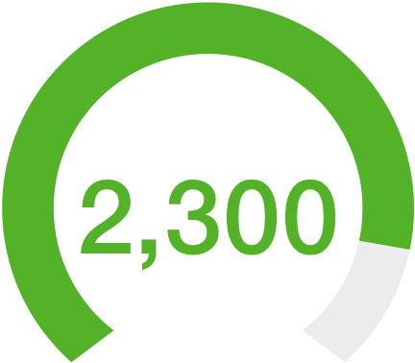
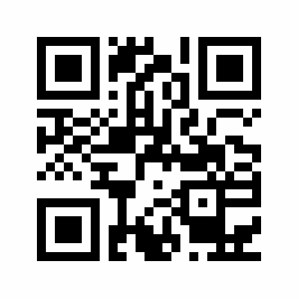



by Cornell Design and Tech Initiative
www.CUreviews.org
CU Reviews 2018: Course Feedback by Cornell Students, for Cornell Students
Site Statistics
User Research
We have surveyed 200+ students online and have conducted 25 in-person interviews to learn more about how students currently choose their classes and the problems they face in the process. From this we discovered that students wanted a more comprehensive idea of different aspects of a class before enrolling. Most commonly, people emphasized their desire to know more about a class’ workload, difficulty, median grade, professor, overall quality, syllabus and get extensive student feedback.
Reviews Lifetime Users Scan to Access
Our Solution
CU Reviews was developed as a way for students to get advice about the many courses offered at Cornell to help them better choose which ones to take. The website is a place for Cornell students to anonymously give honest reviews of the classes they have taken, as well as provide metrics on the aspects of the class listed below. This comprehensive system of peer-to-peer advice sharing is a powerful platform that represents the wide range of opinions that students have about the courses they have taken.
The Problem
From our own experiences, and those we have heard from others, many Cornell students struggle when deciding what classes to take each semester. To find out if a class is interesting or relevant, students often rely on advice from upperclassmen who have previously taken the class. However, students do not always have these connections, or they want to hear a range of opinions before making their decision about whether or not to enroll in a class.
Median Grade
Difficulty
Overall Quality
Feedback
Team Members
Product Managers: Brooke Docherty • Divyansha Sehgal
Developers: Jessica Chen • Julian Londono • Vinisha Mittal • Nihar Sidhu
Designers: Jesse Mansoor • Jessica Prague
Notes:
Gauges for # of reviews/lifetime users
Colored squares with number for number of PMs, devs, designers, etc.

